Slide 1
LFS User Workshop
Martina Helme / Simon Woodsford
ONS Social Survey Operations – Labour Force Survey Research Team

Slide 2
Session 1
Survey history and design
Background/history
Methodology (questionnaire content, sampling, imputation, data collection)
Changes made in response to COVID-19

Slide 3
What is the Labour Force Survey?
A survey of the employment circumstances of the UK population
Largest continuous household survey in the UK
Over 1000 variables (questions and derived variables) covering:
Job industries
& occupation
Earnings & benefits
Employment patterns &
hours worked
Health,
well-being, sickness
Education & training
General household characteristics

Slide 4
Overall Sample Design
People living in private households and nurses in NHS accommodation
Students in halls of residence or boarding schools should be included at their parents address
The Postcode Address File (PAF) is the main sampling frame
NHS sampling frame and the Telephone Directory also used
Other communal establishments are excluded from the sample
Random sample, stratified by postcode
Representative of the whole UK population (with a few exceptions)

Slide 5

LFS Sample
Around 75,000 households sampled each quarter for the LFS and around 40,000 households take part
This equals around 90,000 individuals every quarter
Sample intended to be representative of the entire population
Therefore each case weighted by age, sex and geography
65 million people ÷ 90,000 = each respondent is equivalent to approximately 800 people
75+ households and multiple households will have much larger weights
The LFS is not of a sufficient size to allow for analysis at below Regional level
Notes:
Equates to 120,000 individuals per quarter.
Its aim is to be representative of the whole UK population. Exceptions include those living in communal establishments and those in Halls of Residence (under review, but currenrly captured at parental address

Slide 6
The LFS Wave Structure
JM20
Wave 1
Wave 2
Wave 3
Wave 4
Wave 5
Respondents are interviewed for five successive waves at three-monthly intervals
20% of the sample is replaced every quarter
AJ20
Wave 1
Wave 2
Wave 3
Wave 4
Wave 5
JS20
Wave 1
Wave 2
Wave 3
Wave 4
Wave 5
OD20
Wave 1
Wave 2
Wave 3
Wave 4
Wave 5
JM21
Wave 1
Wave 2
Wave 3
Wave 4
Wave 5

Slide 7
Annual Population Survey (APS) Sample
Main purpose of the APS is that analysis can be conducted at Local Authority level
The ‘boost’ cases ensure a set number of cases for each Local Authority are targeted
Around 200,000 households are contacted…
Around 140,000 households take part,…
Equates to around 280,000 individuals

Slide 8
What is the connection between LFS and APS?
LFS
APS

Slide 9
The LFS Boost Wave Structure
2017
Wave 1
Wave 2
Wave 3
Wave 4
England, Scotland and Wales all fund Local Labour Force Survey interviews (LLFS, Boost or Enhancement cases)
Respondents are interviewed for four successive waves at 12-monthly intervals
25% of the sample is replaced every quarter
2018
Wave 1
Wave 2
Wave 3
Wave 4
2019
Wave 1
Wave 2
Wave 3
Wave 4
2020
Wave 1
Wave 2
Wave 3
Wave 4
2021
Wave 1
Wave 2
Wave 3
Wave 4

Slide 10
The APS Wave Structure
The APS is made up of LFS W1 and W5, and the LFS Boost W1-4
2017
LFS W1
LFS W5
Boost W1
Boost W2
Boost W3
Boost W4
2018
LFS W1
LFS W5
Boost W1
Boost W2
Boost W3
Boost W4
2019
LFS W1
LFS W5
Boost W1
Boost W2
Boost W3
Boost W4
2020
LFS W1
LFS W5
Boost W1
Boost W2
Boost W3
Boost W4
2021
LFS W1
LFS W5
Boost W1
Boost W2
Boost W3
Boost W4

Slide 11

Imputation
Rolled forward imputation
A successful interview at one wave followed by a non-response at the next
Rolled forward cases appear as IOUTCOME = 6 on LFS and APS ‘person’ and ‘household’ micro data
Rolled forward imputation only occurs once and only for LFS main cases
Donor imputation (employment focused)
Non-response at wave 1 or a second consecutive wave of non-response
Non-responder cases appear as IOUTCOME = 3 only on LFS and APS ‘household’ micro data
Donor imputation occurs for LFS and APS cases

Slide 12
Data collection (pre-COVID)
CAPI (Computer Assisted Personal Interviewing)
Scotland north of Caledonian Canal all done by telephone unit
Approximately 600 field interviewers and 200 telephone interviewers
Respondents can answer for others in the household = Proxy Interviews
Around 1/3 of LFS data collected in this way
Wave 1
Waves 2-5
Face-to-Face
Telephone
Notes:
The data are collected using CAPI; Computer Assisted Personal Interviewing. This involves an electronic questionnaire, designed using software called Blaise.
For the majority of wave 1 cases, the questionnaire is asked by field interviewers who visit respondents’ homes.
However, waves 2-5 are conducted by the telephone interviewers in the Telephone Unit in Titchfield.
If respondents prefer, they are able to request that the subsequent waves be conducted face to face instead of over the phone.
The primary reason for using the TU is to reduce costs. The interviews also tend to be shorter than the wave 1 so it is more efficient and convenient to use telephone interviewing.
North of the Caledonian Canal is sparsely-populated which makes face to face interviewing very expensive. As a result the interviews are conducted over the telephone as this reduces costs.
One third of LFS data are collected by proxy and studies have shown that the reliability of such data is generally good.

Slide 13
Field process
05
04
Start of data collection
03
Second advance letter sent out by interviewers locally
02
First advance letter and unconditional incentive sent out centrally approx. 10 days before the start of the field period
01
Sampled addresses get divided into 13 weekly stints and allocated to interviewers across GB (NISRA conducts fieldwork for NI)
Sample drawn for each quarter separately three months in advance of the field work.

Slide 14
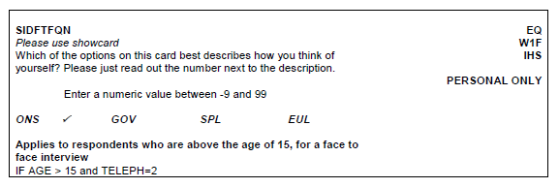
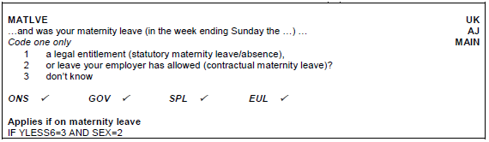
Variable frequency
Certain variables are wave specific
Others are quarter specific

Slide 15
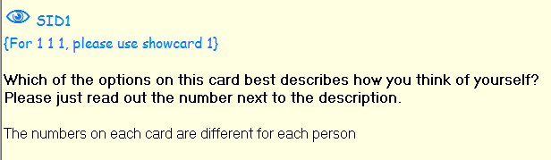
Data quality at point of collection (1)
We provide showcards for questions such as nationality, ethnicity and sex ID
Notes:
We don’t provide showcards for a lot of other questions where you might expect them because they have a lot of answer options (e.g. education qualifications) ….why don’t we?

Slide 16
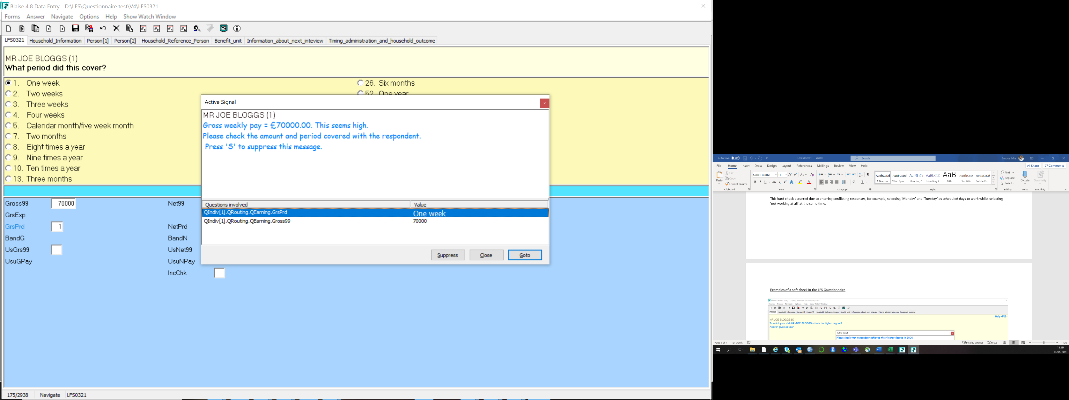
Data quality at point of collection (2) – Soft checks
Notes:
This soft check has occurred due to the respondent entering an unusually high salary. The gross pay value entered was £70,000 and period given was weekly (1). This is more likely to have been an annual salary.

Slide 17
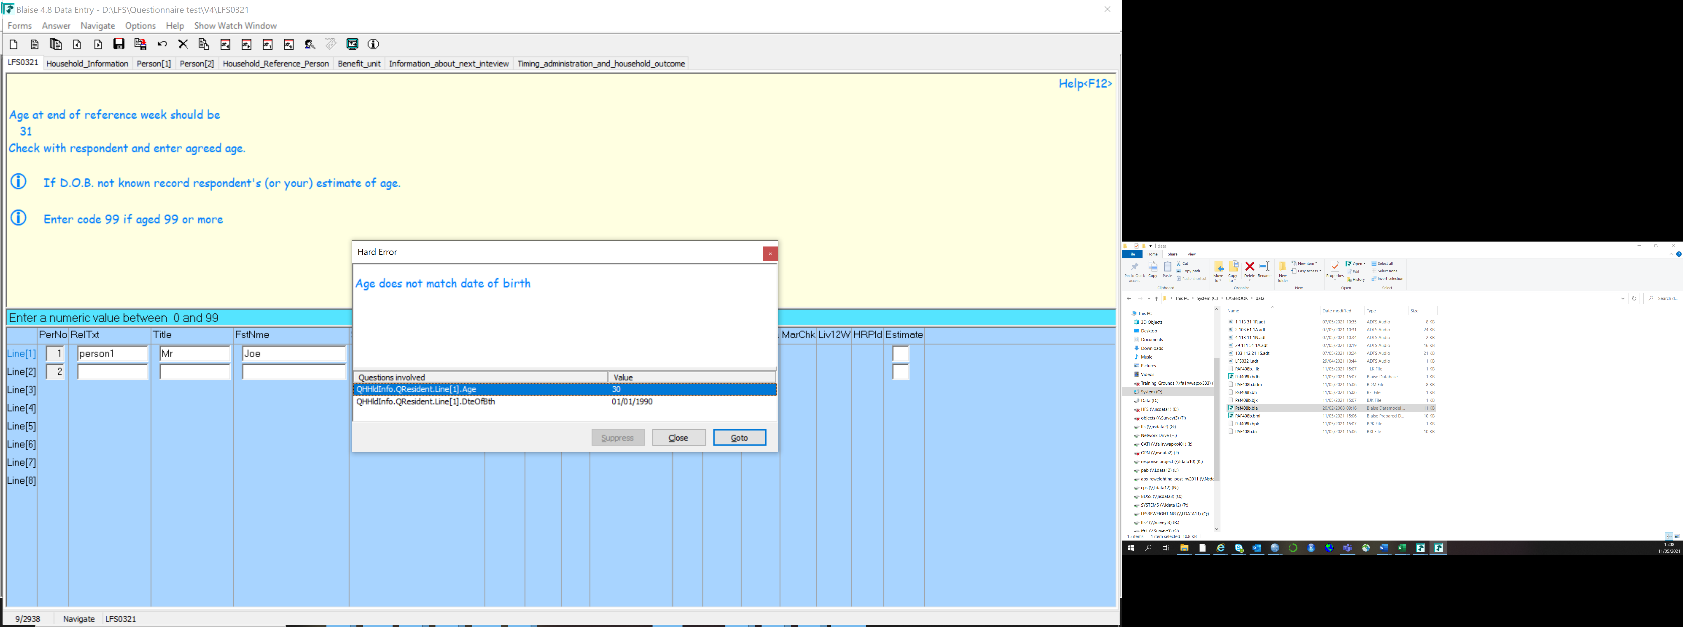
Data quality at point of collection (3) – Hard checks
Notes:
This hard check has occurred as DOB does not match respondent’s age.

Slide 18

Changes to the LFS/APS since the start of the pandemic

Slide 19
Timeline of events
30/03 Telephone interviewing rolled out to F2F interviewers
17/03 F2F data collection suspended
01/07 W1 sample size doubled
09/03 Public awareness starts affecting survey participation
23/03 UK lockdown begins
20/04 Online portal for telephone details
Notes:
9 March 2020: The public's heightened awareness of the coronavirus started to affect participation in the LFS.
17 March 2020: Wave 1 face-to-face data collection was suspended, in line with government guidelines, while systems were developed to allow interviewers to conduct telephone interviewing from their homes.
Telematching, which uses lookup information on telephone numbers associated with addresses (already used for respondents north of the Caledonian Canal) was extended to the rest of Great Britain to obtain additional telephone numbers for addresses in Wave 1.
LFS Waves 2 to 5 continued to be conducted via telephone where possible.
23 March 2020: Commencement of official UK lockdown measures.
Face-to-face interviewers restarted interviewing intermittently using telephone mode. Additional advance materials were prepared to allow respondents to contact interviewers.
30 March 2020: Telephone interviewing was rolled out fully to face-to-face interviewers.
20 April 2020: A new online portal was put in place to allow improved collection of respondent telephone details.
1 July 2020: Wave 1 sample size was doubled.

Slide 20
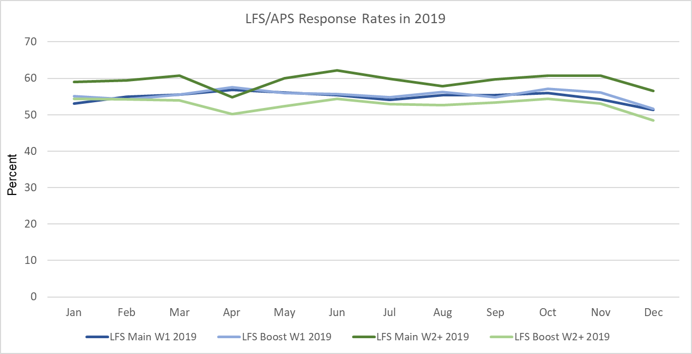
Impact of COVID-19 on LFS Response Rates
Notes:
With the public awareness of COVID increasing rapidly in February and March, the survey response rates were obviously heavily affected by this. Here you can see the usual level or response rates on the LFS main and boost samples for W1 and W2+ - all between 50 and 60% over the course of 2019. This was still true for January and Feburary 2020.

Slide 21
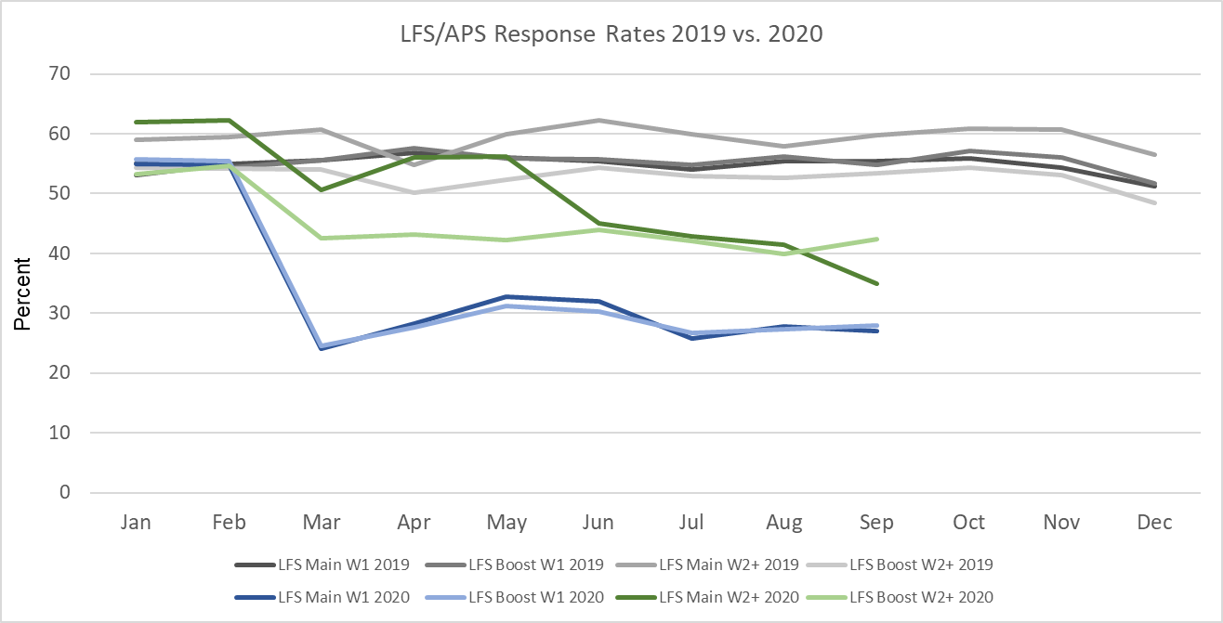
Impact of COVID-19 on LFS Response Rates
Notes:
But with beginning of March response rates for the LFS W1 sample considerably dropped to between 25 to 30%. The W2+ sample was also affected, but not as much.
Since the face-to-face was paused on 17 March 2020, the size of the sample in the last two weeks of March was lower than it should be. The distribution of the sample should be approximately even over the weeks of a quarter. This had a knock-on effect in subsequent rolling quarters. To address this issue, we introduced a calibration control to ensure that the weighted distribution of the sample was evenly distributed over the weeks of the quarter within GB and NI.
[Bob suggested, we should say something about the introduction of weekly constraining to the weighting, so that even with the different levels of response, each week has roughly level weight within the three-month estimates.] → waiting for further info from Salah on this!

Slide 22
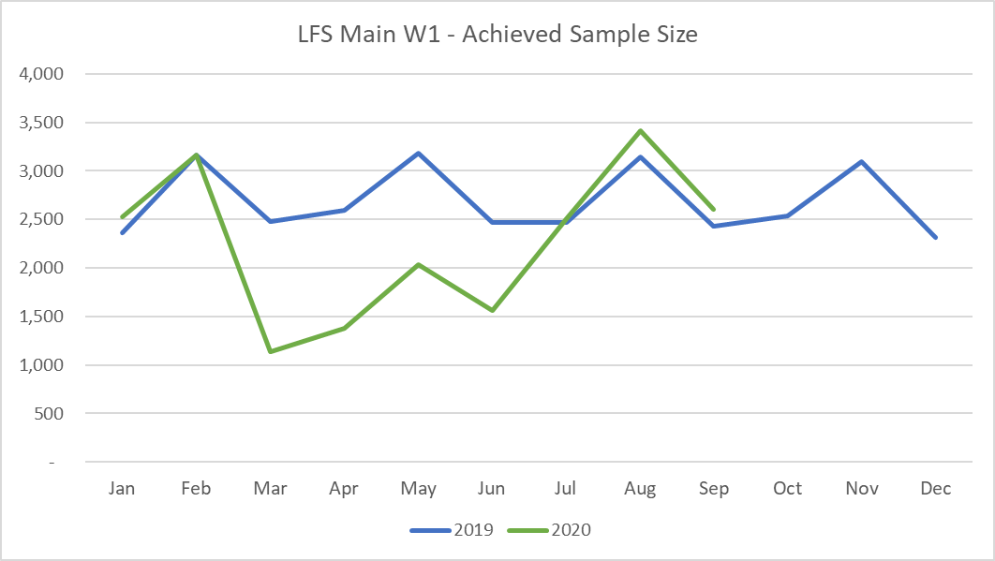
Impact of COVID-19 on LFS achieved sample size
Notes:
This graph illustrates the drop in the achieved sample size in the second quarter of the year. Due to the increase of the sample boost in the third quarter, the W1 sample size recovered to previous year levels. However, it should be noted that as there is currently no face 2 face contact with sampled addresses, the characteristics of the achieved sample differ to some extent.

Slide 23
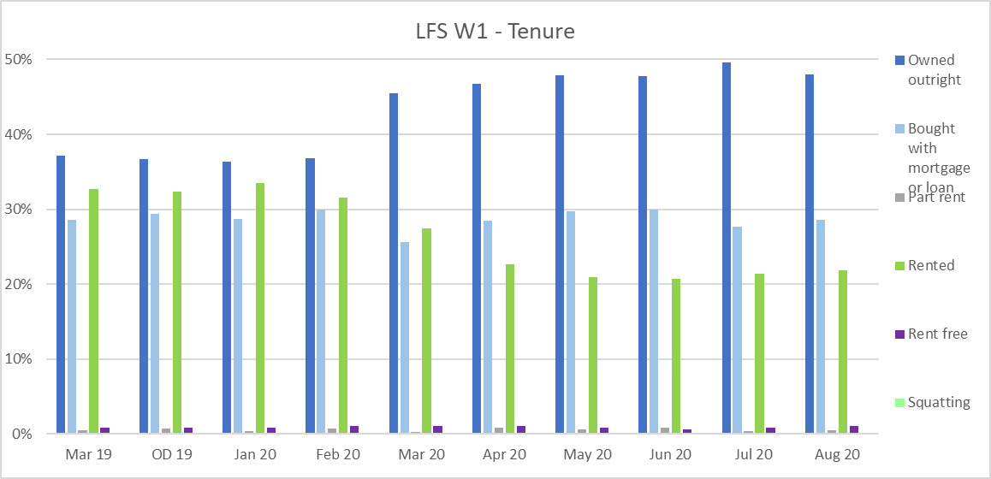
Impact of COVID-19 on LFS estimates
Notes:
When responses started to drop back in March, colleagues in the LMD started looking for patterns in weekly experimental datasets. At that point experimental weights were produced for these datasets to be able to assess what was happening in the data.
The change in non-response bias was significantly evident in a change to the housing tenure of the Household Reference Person, with a lower proportion of rented addresses being included and an increase in the proportion of those owned outright by the occupier. Here you can see the distribution amongst W1 respondents.

Slide 24
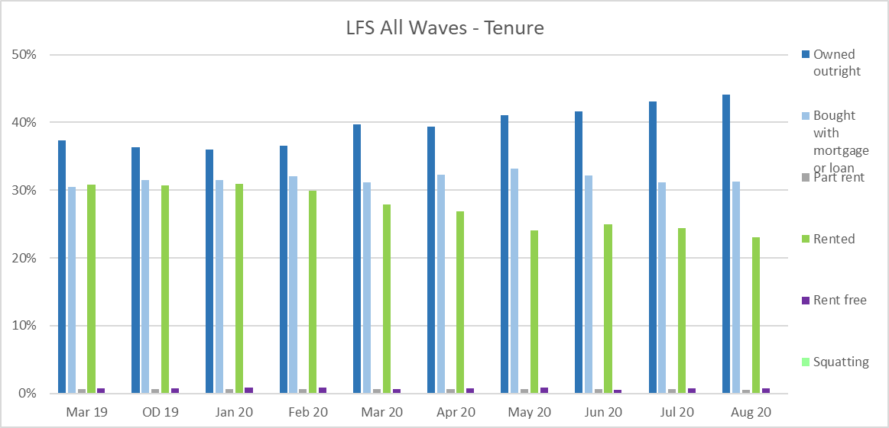
Impact of COVID-19 on LFS estimates
Notes:
And here for all waves together.
To address this issue, we introduced housing tenure into the LFS weighting methodology. All published LFS and APS datasets will now use this tenure weighting going forward.
I would like to add that we recognise that this adjustment is not a perfect solution, but it has rectified some of the issues that had previously been noted in the survey results. However, we are continuing investigations to see whether the tenure methodology can be enhanced.

Slide 25
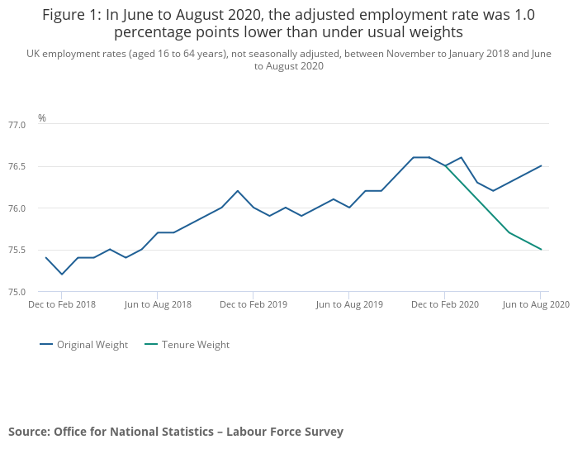
Notes:
I have got here a few graphs from the publication in October, which demonstrate what impact the weight adjustment had.

Slide 26
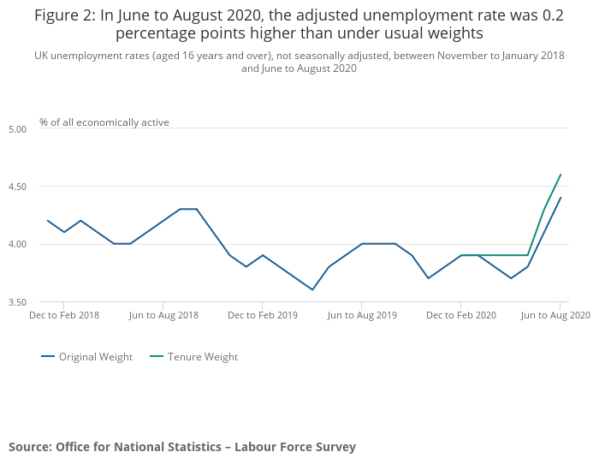

Slide 27
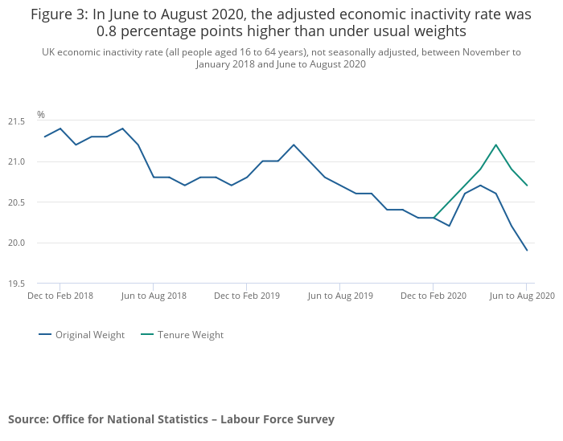
Notes:
Re publication of reweighted datasets:
LFS person microdata re-published last month
LFS Longitudinal two-quarter microdata and APS Person, Income and Wellbeing mircodata were released earlier this month, along with all the latest information for the Jul-Sept 20 period
Revised LFS Household microdata will not be released tomorrow (25th November)
ONS is planning to reweight LFS/APS data back to 2020 with a refined adjustment reflecting on the non-response bias and the under-representation of non-UK born. A methods paper is to be published in May.

Slide 28
Questionnaire up-dates
Sickness absence
Reasons respondent was away from work or worked fewer hours in the reference week
Reasons respondent worked more hours than usual in the reference week
Reasons why the respondent was paid less than usual
State benefits (furlough, SEISS)
Home/flexible working
Notes:
Additional questions were added at Illne20/Illfst20/Illnxt20 to capture whether a sickness absence was due to COVID19. The new set of questions routes from the answer category ‘other’ as it was felt being the best fit available to avoid causing a disruption for the time series of the existing main sickness absence categories.
Several departments have a need to understand circumstances of furloughed workers. In order for us to monitor the impact of COVID19 on the labour market, it is important that Wrking and JbAway (away from job/business in the reference week) are answered correctly. We provided interviewers with further instructions on how COVID19 related work changes need to be considered for existing questions. Any respondents who have a job that has been temporarily suspended (with or without pay) should answer “no” to Wrking (doing paid work in the reference week), but “yes” to JbAway (away from job/business in the reference week). Where JbAway is answered with “yes”, respondents are routed to the new questions that will identify furloughed workers. Only those who have permanently lost their job due to coronavirus should answer “no” at JbAway.
Respondents are also be asked new questions if they are working more hours than usual. All options at Ymore will route to the new COVID questions to ensure all respondents affected by coronavirus are identified. Coro20b3 also includes options covering health workers and key/essential workers in other industries.
Just before the start of the state benefits section we have added a question that asks the respondent whether they are receiving support from two specific coronavirus-related schemes. It captures respondents receiving benefits through the Job Retention Scheme and the Self-employment Income Support Scheme. We recognise that respondents may not necessarily be aware of what scheme they are/were receiving support from, so the question also covers a ‘neither’ and ‘don’t know’ option.
New questions have also been added to the pay section to establish why respondents where receiving less pay than usual. It is important to note that the usual pay information reflects the respondent’s standard pay BEFORE the coronavirus outbreak and that the recent pay reflects their current situation. This will allows you to analyse the impact of the outbreak on pay.
Availability of LFS/APS datasets through the SRS have been much slower than normal since COVID (due to increase in data ingest; SRS resource); Not all COVID variables available on the UKDS or SRS versions, so far we’ve only made available what Labour Market have used in their published COVID analysis (this is largely centred around confidence in the variables). But we are now working on adding all COVID variable to the data files stored in the SRS (subject to SRS resource to progress this asap) and to UKDS files (subject to sign-off by SDC).

Slide 29
Survey changes since AJ20 as a response to COVID-19
Collection of email address for each household (Main W1-4, Boost W1-3) to allow respondents to be contacted via email in case the postal system is disrupted.
Telematching of entire W1 sample
Telephone interviews for entire sample
Online portal to collect telephone numbers of respondents
LFS W1 sample size increase by 100% for JS20 and OD20, and by 60% from AJ21 onwards (inc. Knock to Nudge)
Adjusted weight calibration using tenure to address bias in the estimates with a further weight adjustment to be applied later this year.
Notes:
Telematching is usually just carried out for sampled addresses north of the Caledonian Canal. This was extended to the entire W1 sample in order to change from face to face to telephone interviews.
In addition to that we set up an online portal for sampled households to enter their telephone numbers.
We have so far doubled W1 sample sizes for JS20 and OD20
And in light of the impact of estimates adjusted the weight calibration to include tenure.

Slide 30
What the future holds
Reweighting exercise on going this year.
Weight adjustment based on comparison with RTI data
Detailed methods paper to be published in a few weeks
Currently working on a roadmap back to in-house/F2F interviewing (trial planned for later this year)
Ongoing development of the Labour Market Survey
LMS together with a combination of admin data will replace the LFS
On-line first
Mixed mode data collection
Latest results from the 2019 mixed-mode test published on ONS website
Notes:
To collect labour market data via an online-first collection design, a new prototype product is being developed called the “Labour Market Survey” (LMS). The LMS is a mixed-mode survey that focuses on the core data collection requirements needed to produce labour market estimates. It is anticipated that after the integration of administrative data into the estimation system for labour market statistics, the LMS could replace the LFS and be the instrument used to collect any residual survey data requirements. The LMS would also be used to collect socio-demographic variables, which would allow the survey data to be linked to the administrative data sources. The design of the LMS is still in development and, as such, is currently a prototype. It is based on the design of the LFS, but there are some differences between the two products
The online-only LMS was released in March 2020, comprising of a core set of questions that deliver variables critical to the delivery of our monthly Labour market publications. .
In 2019 a large scale mixed mode test was conducted offering online mode first with a face-to-face follow-up. The results of this test are published on the ONS website.
A further mix-mode test, offering online first with a telephone follow-up, was conducted in February 2020. This was on a much smaller scale and with the view to test practicalities around the field data collection. The result from this test were very promising and the launch of the telephone mode as a follow-up to the online mode is planned for July this year.
It has not yet been decided when the LMS would replace the LFS as there is still further development ongoing.

Slide 31
More information on the LMS
LMS Technical Report
LMS Characteristics Report
LMS Comparative Estimates Report

Slide 32
Session 2
Considerations when using the data
Datasets - scope/limitations
What to know about weights
What to know about variables
Data linking/pooling

Slide 33
Dataset overview
LFS person level data - quarterly
LFS household level data - now all quarters
LFS longitudinal data – 2 quarters and 5 quarters
APS person level data - quarterly, covering 12 months
APS household level data – annually
APS 3 year pooled data – annually
Government level files
Public files (now only end user licence)
Data accessible from UK Data Archive/SRS

Slide 34
LFS Person level data
Purpose → Personal level analysis at a national or regional level
Frequency → Quarterly – official released around 6 weeks after the end of data collection period, available through UKDS/SRS several weeks later
Time periods → Normally released for calendar quarters only (e.g. Jan to March)
Availability → AJ92 to AJ01 (2007 weight) JS01 to AJ11 (2014 weight)
JS11 onwards (2018 weight)
Weights → PWT (person analysis) and PIWT (earnings analysis)
Limitations → Not for analysis below regional level
No earnings information for self employed
Some variables are specific to certain quarters
Not for Well-Being, Sexual Orientation, Family/Household analysis

Slide 35
LFS longitudinal data for 2 quarters
Purpose → Conducting analysis on flows over 3 months
Frequency → Quarterly – official released around 6 weeks after the end of data collection period, available through UKDS/SRS several weeks later
Time periods → Two calendar quarters only (e.g. JM to AJ)
Availability → Q197-Q297 to Q306 –Q406 (2007 weight) Q107-Q207 to Q211-Q311 (2014 weight) Q311-Q411 onwards (2018 weight)
Weights → LGWT
Limitations → Only available for person level analysis Only includes respondents who responded in both quarters Only includes variables asked in both quarters
Doesn’t contain all variables available on LFS person datasets
Notes:
LFS respondents are interviewed 5 times in total – once every quarter for a year. This allows certain longitudinal analysis to be performed on the data, particularly relating to employment information.

Slide 36
LFS longitudinal data for 5 quarters
Purpose → Conducting analysis on flows over 12 months
Frequency → Quarterly – official released around 6 weeks after the end of data collection period, available through UKDS/SRS several weeks later
Time periods → Five calendar quarters only (e.g. JM to AJ)
Availability → Q1’05-Q1’06 to Q2’10-Q2’11 (2010 weight) Q3’10-Q3’11 to Q2’11 to Q2’12 (2014 weight) Q2’12 –Q3’13 onwards (2018 weight)
Weights → LGWT
Limitations → Only available for person level analysis Only includes respondents who responded in all 5 quarters
As a result sample size drastically reduced Doesn’t contain all variables available on LFS person datasets
Notes:
The variables FLOW (labour force gross flow over a 12 month period) and ANFLOW (labour force gross flows across all five quarters) are available on the datasets. They give the categories relating to labour force gross flows in a convenient form.

Slide 37
APS Person level data
Purpose → Personal level analysis below regional level or for breakdowns on certain characteristics
Frequency → Quarterly – official released around 11 weeks after the end of data collection period, available through UKDS/SRS several weeks later
Time periods → Rolling 12 months (e.g. January to December, April to March)
Availability → JD04 to JD11 (2014 weight) A11M12 onwards (2018 weight)
Weights → PWTA (A05M onwards, before then PWAPS, PWLFS) PIWTA (for earnings analysis) – JD only from 2012-17, all periods from 2018 onwards SIDWT (for Sexual Orientation analysis) – 2011 onwards
NPWT (for Personal Well-being analysis) – 2011 onwards
Limitations → Some LFS quarterly specific variables not available on APS
Notes:
It is important to note that the size of the achieved sample for the Well-Being and Sexual Identity variables within the APS dataset is much smaller than the full APS file. This reduction is due to the Well-Being and Sexual Identity questions only being asked of persons aged 16 and over, who gave a personal interview; proxy answers are not accepted. As a result some caution should be used when analysing responses to WellBeing and Sexual Identity questions at detailed geography areas, or other variables, where unweighted respondent numbers maybe relatively small

Slide 38
APS longitudinal data for 2 years
Purpose → Personal level analysis on flows below regional level over 12 months
Frequency → Annual
Time periods → January to December for two consecutive years
Availability → JD12 - JD13 onwards (2018 weight)
Weights → LGWT
Limitations → Only at person not household level Only for a sub-set of variables Only includes respondents who have responded in both years
Notes:
It is important to note that the size of the achieved sample for the Well-Being and Sexual Identity variables within the APS dataset is much smaller than the full APS file. This reduction is due to the Well-Being and Sexual Identity questions only being asked of persons aged 16 and over, who gave a personal interview; proxy answers are not accepted. As a result some caution should be used when analysing responses to WellBeing and Sexual Identity questions at detailed geography areas, or other variables, where unweighted respondent numbers maybe relatively small

Slide 39
APS 3-year pooled person level data
Purpose → Personal level analysis at lower level geographies and for certain topics where achieved sample is much smaller
Frequency → annual – normally released around July every year
Time periods → January to December covering 3 years
Availability → JD13 to JD15 (2016 weight) JD14 - JD16 to JD15 - JD17 (2017 weight) JD16 - JD18 to JD17 to JD19 (2018 weight)
Weights → PWTA**C, SIDWT**C and NPWT**C
Limitations → Point in time estimates and not to be used for any time series analysis
Notes:
The pooled dataset should be treated solely as point-in-time estimates and not for any time series analysis. This is because two consecutive datasets will contain 2 years of the same information (e.g. if comparing J14D16 with J15D17, 2015 and 2016 information will be included in both, so what you are really comparing is 2014 with 2017, which ISN’T advisable) More information on the 3 pooled dataset can be found in user guide volume 6.

Slide 40
LFS Household level data
Purpose → household/family level analysis at a national or regional level
Frequency → Quarterly - Officially released around 8 weeks after the end of data collection period, available through UKDS/SRS several weeks later
Time periods → Pre 2004 – Apr-Jun periods only; Between 2004 and 2011 Apr-Jun and Oct-Dec only; Quarterly from AJ12 onwards
Availability → AJ96 to AJ01 (2007 weight) AJ02 to AJ11 (2014 weight) OD11 onwards (2018 weight)
Weights → PHHWT
Limitations → Not suitable for household earning analysis as no earnings household weight
Notes:
The LFS is a household survey that tries to collect information for all eligible people in a sampled household. The LFS can therefore be used to conduct household and family level analysis. For example, the ONS uses the LFS to publish analysis on workless households. There are two datasets available for household/family analysis that all serve different purposes → LFS household and APS household.
Generally, when you want a count of the number of households, you need to apply the filter RELHRP6=0

Slide 41
APS Household level data
Purpose → Household and Family level analysis below regional level or for breakdowns on certain characteristics
Frequency → Annually - released around July every year
Time periods → January to December
Availability → JD04 to JD05 (2010 weight) JD06 to JD11 (2014 weight) JD12 onwards (2018 weight)
Weights → PHHWTA
Limitations → Some LFS variables are not available on APS datasets, particularly LFS quarterly specific variables. Not suitable for household earning analysis as no earnings household weight
Notes:
The LFS is a household survey that tries to collect information for all eligible people in a sampled household. The LFS can therefore be used to conduct household and family level analysis. For example, the ONS uses the LFS to publish analysis on workless households. There are two datasets available for household/family analysis that all serve different purposes → LFS household and APS household.
Generally, when you want a count of the number of households, you need to apply the filter RELHRP6=0

Slide 42
What to know about LFS/APS weights
LFS/APS collects data on a representative sample of UK population
Grossing weights are created to estimate for the rest of the UK population we don’t sample and the survey design
Weighting groupings are by age, sex and geography
Each individual represents around 800 people of similar characteristics (LFS person weights)
Sum of the weights make up the eligible population in the UK
Critical to make sure you use the appropriate weight for the analysis you are doing
Notes:
The LFS collects information on a sample of the population. To enable us to make inferences from this sample to the entire eligible population we must weight the sample data. This entails assigning each responding or imputed case a weight (GROSSING WEIGHTS), which can be thought of as the number of people in the population which that case represents.
The sum of the weights on any dataset make up the eligible population of the UK. Population weighting serves several purposes. It ensures that estimates reflect the sample design so that cases with a lower probability of selection will receive a higher weight to compensate.

Slide 43
What to know about variables
Datasets contain questionnaire variables; derived variables; geography variables; system variables, all can be used for analysis
Details of all variables can be found in UG2, UG3 and UG4
Not all variables will be on all datasets
Well-Being; Sexid; Smoking; Veterans; General Health; Quality of work – APS only
Family and Household variables – Household datasets only
Quarterly specific variables – LFS datasets only
Reduced variables list on Longitudinal datasets
Understand the variables you are using (e.g. periods; type; routing)
Datasets will include ‘missing values’
-9 means not routed to that specific question
-8 means respondent refused to answer question or answered don’t’ know
Notes:
Some are specific to quarters or LFS or APS only (examples?)
Missing values
Data brought forward

Slide 44
Data linking/pooling
It isn’t advised to carry out any dataset linking or pooling yourself
Pitfalls of doing this include no suitable weights and duplicate cases
The LFS and APS datasets available should allow you to carry out all permitted analysis
Data linking procedure links cases across waves using
A unique case identifier (not available via UKDS)
Sex
DoB
Name and address information not available on any LFS/APS datasets
Pseudo identifiers available on LFS UKDS datasets
Notes:
LINKING PROCEDURE The individual-level LFS dataset for the first of the period to be linked (quarter for the LFS or yearly for the APS) is used to produce a reduced cross-sectional dataset confined to the age range and variables to be used for the longitudinal dataset. A unique identification variable (PERSID) is created. A similar procedure is followed on the datasets for the other periods that are to be linked. The datasets for the two quarter, five quarter or two year to be linked are matched by the unique identification variable and checked to ensure that the cases linked match also on sex and date of birth. All unmatched cases are dropped, as are all cases where the data were rolled forward, or where there are no data on economic activity, at any of the quarters.
POOLING PROCEDURE

Slide 45
Which dataset to use when?
Analysis on sexual orientation → APS person (SIDWT)
Analysis on wellbeing → APS person (NPWT)
Analysis on earnings below reg. level → APS Person (PIWTA)
Analysis on other topics below reg. level → APS Person (PWTA)
Analysis on earnings at or above reg. level → LFS Person (PIWT)
Analysis on other topics at or above reg. level → LFS Person (PWT)
Longitudinal analysis below regional level → APS Person 2yr (LGWT)
Longitudinal analysis at or above regional level → LFS 2Q or 5Q (LGWT)
Analysis at hhold/family level below reg. level → APS Hhold (PHHWTA)
Analysis at hhold/family level at or above reg. level→ LFS Hhold (PHHWT)

Slide 46
How to get started…
Always refer to LFS/APS user guides first:
UG1 – LFS (and some APS) Methodology
UG2 to UG4 – Questionnaire and Derived Variables
UG5 – Classifications (SIC/SOC)
UG 6 - APS
UG8 – Household and family variables
UG9 – Eurostat
UG10 – Advice on which dataset to use
UG11 – Longitudinal
Key things depending on your analysis:
Use the correct dataset
Use the correct weight
Use the correct variables

Slide 47
Q&A

